Slide 1
Smart-M3 security
OSLL, ETU
Notes:
Investigated basic problems of security in the platform, it was decided to add the most basic mechanisms:
1. To control access to the SS, it is necessary to develop mechanisms for identifying and authenticating SS clients that allow to monitor and prevent unauthorized access to the SS;
2. To protect the integrity and data access should provide SS subjects authorization mechanism to control access to SS data based on access rights assigned to each SS subject.

Slide 2
Security model development
Main security mechanisms:
Identification and authentication of space subjects:
  HIP, PAM;
Authorization and access control of space subjects:
  discretionary security model;
  smart space RDF-graph mapping to the virtual file system (VFS);
  named graphs;
  access control ontology;
  security extensions for smart space database.
Notes:
For the implementation of identification and authentication mechanisms can be used HIP protocol and PAM (pluggable authentication modules). In our case, we use HIP protocol.
As the mechanisms of authorization and access control can be used: SS RDF-graph mapping to the virtual file system (VFS, it is the ultimate solution in this work and we will pay more attention to it), named graphs (closer to the area solution that can be added later), ontology restrictions (ontology that will track all the operations of agents, but due to continued access to the ontology, the performance of this decision will be much worse) and some security extensions to the SS database.

Slide 3
Smart-M3 security realization
Identification and authentication mechanisms
  prospective architecture of HIP-agent;
  interaction of HIP-agent components.
Authorization and access control mechanisms
  smart space RDF-graph mapping to the VFS;
  intermediate solution of the graph mapping;
  implementation mechanism to the Smart-M3 platform.
Notes:
As a solution of identification and authentication was selected HIP protocol, which allows you to organize a secure connection between all SS clients.
As a solution of authorization was proposed not quite standard solution, SS RDF-graph mapping to the VFS, VFS has been unnecessarily spent access control mechanisms that are at the correct representation can work in the field of representation of semantic information.

Slide 4
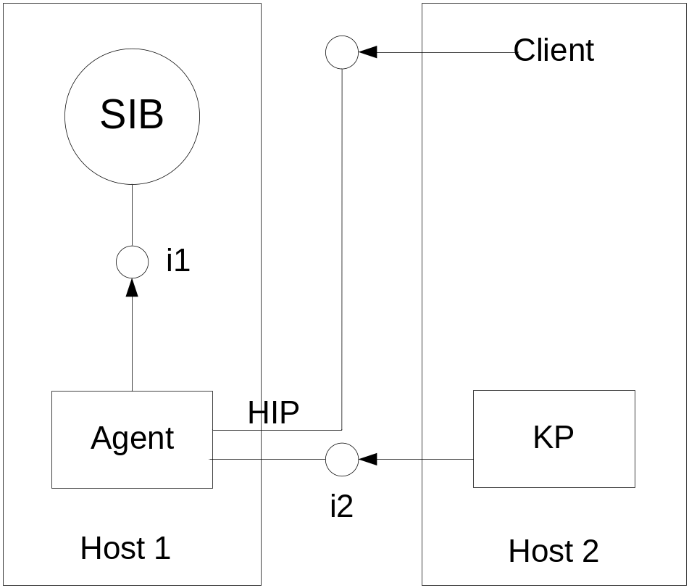
Prospective architecture of HIP-agent
Identification and
authentication of the client:
Client connection request to the SS;
Request intercepting by HIP-agent;
Protocol-based HIP identification and authentication of the client.
Notes:
For identification and authentication of the SS clients on the basis of the HIP-protocol will be developed HIP-agent.
There are two hosts, SS host (SIB) and the client (KP). When a client (KP) connects to the smart space (SIB), the connection is intercepted by HIP-agent, which identifies and authenticates the client based on the HIP-protocol. Client and server sides must be configured to work via HIP.

Slide 5
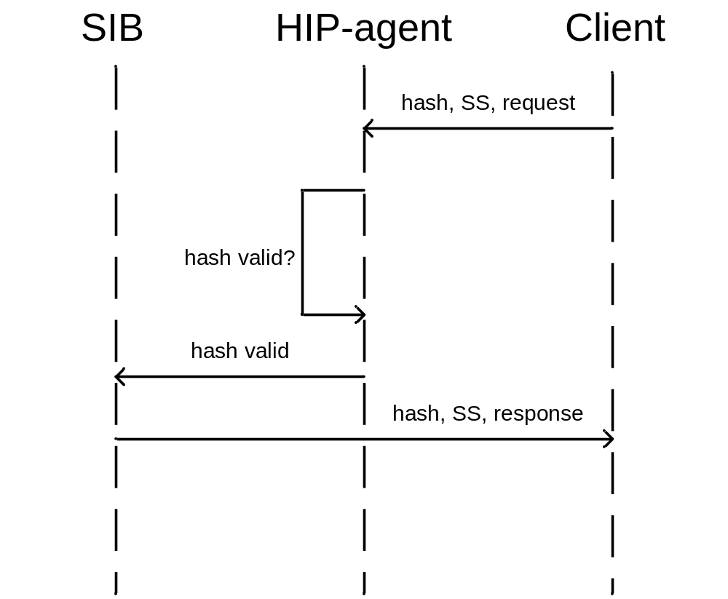
Interaction of HIP-agent components
The process of connecting
the client to the space:
Transmission the client hash key to HIP-agent;
Checking the hash key to validity;
Identification and authentication of the client;
Connection to the SS.
Notes:
The process of the client connection to the space shown in a sequence diagram. Client communication with HIP-agent using the standard Socket API. When connected, the client sends the hash key, on the basis of which is made a decision on the identification and authentication of the SS client. If the hash is valid, the agent connects the client to the space (SIB).

Slide 6
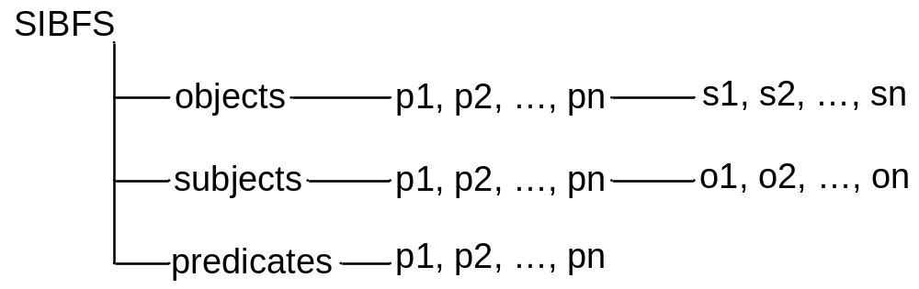
Smart Space RDF-graph mapping
information of SS is stored in a relational database, smart space database (SQLite);
information of SS is presented in triple form (S, P, O);
set of triples stored in specific database tables;
Solution: The virtual FS, that mapping information of SS in a certain directory structure.
Notes:
All SS information is stored in the relational database, SS database. Smart space information presented in the triplets form. The totality of these triples is stored in a specially defined database tables of the Smart-M3 platform. All of the SS database tables can be found in SQL-script "createDB.sql" platform Smart-M3 module piglet_m3.
After some research, it was decided to develop own virtual file system, which mapping SS information that is stored in a database tables in a certain directory structure for subsequent operations on them. The directory structure of the virtual file system is shown at the picture.
The directory structure has a structure that allows you to receive information in the form of "subject (s), predicate (p), object (o)", vice versa and all predicates (relations). The implementation of the RDF-graph mapping to the VFS can be realized using the FUSE technology. Any Linux file system provides standard attributes to control access to files, directories and other entities of the file system. Thus, the file system provides standard access control mechanisms for the users of the system.

Slide 7
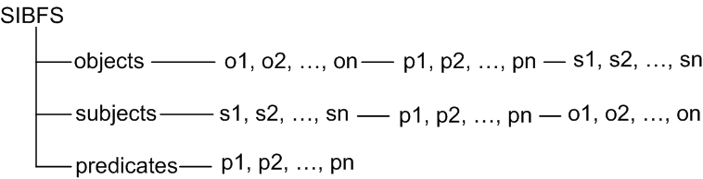
The updated directory structure of VFS:
provide more accuracy right to triplets (information) of the space;
Notes:
This directory structure allows more accuracy right to triplets (information) of the space.

Slide 8
The intermediate solution of graph mapping:
Working with SS database: get all triples and save them in memory of data structure (SQLite)
  receiving all objects, subjects, predicates and their values;
Creating a VFS directory structure based on the data
  creating of virtual FS using FUSE technology (fusekit), setting permissions;
Notes:
The intermediate mapping algorithm consists of two steps:
1. Developing methods for working with SS database:
1.1. receiving all objects, subjects, predicates and their values ​​from the SS database;
1.2. recording received data in the memory or data structure;
2. Creating a virtual file system directory structure from received data:
2.1. developing virtual FS using FUSE technology (fusekit - C++ extension of FUSE);
2.2. setting permissions (after integration into the platform);
SS mapping mechanism is fully developed and tested.

Slide 9
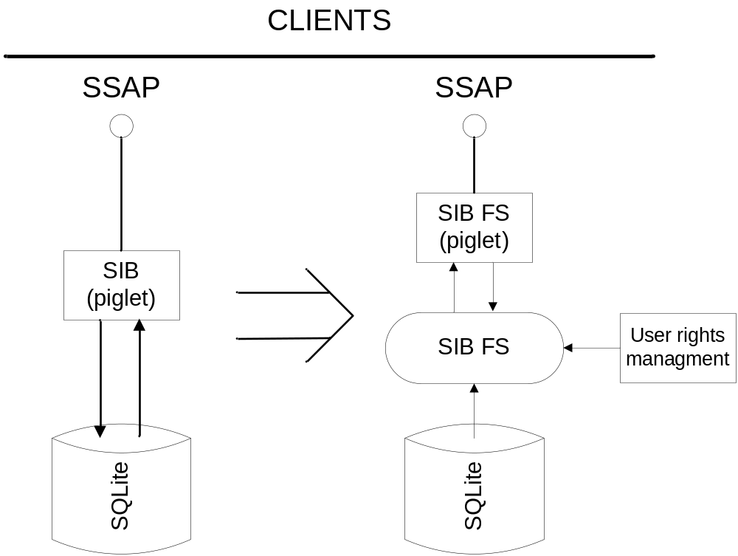
Notes:
After the implementation of the SS mapping mechanism to the platform architecture, we can control the process of SS information access for all of its client (agents, KP).
In the end, we want to completely abandon the SS database and replace it with the file access (virtual file system).

Slide 10
Implementation mechanism to the Smart-M3 platform:
modification of Smart-M3 platform piglet module:
  piglet proxy creation for new extensions;
  replacement of all smart space database operations to mapping FS operations;
  determine and verify client access permissions;
testing operations on the client side.
Notes:
After creating the mapped SS VFS, should the process of implementing a mapping mechanism in the platform. For this plan to do the following steps:
1. modification of Smart-M3 platform piglet module:
piglet proxy creation for new extensions;
replacement of all smart space database operations to mapping VFS operations;
determine and verify client access permissions;
2. testing operations on the client side.
Work on this step is still in progress, was developed piglet proxy and started the process of analyzing the binding of VFS operations to the SS operations.

Slide 11
What was done?
analyzed and designed the HIP protocol-based mechanism of identification and authentication;
the mechanism of authorization and SS subjects access control by mapping RDF-graph to the virtual file system is developed; mechanism tested in the Smart-M3 platform;
the process of implementation mapping mechanism to the Smart-M3 platform is started;
Notes:
analyzed and designed the HIP protocol-based mechanism of identification and authentication;
the mechanism of authorization and access control SS subjects by mapping RDF-graph to the VFS is developed; mechanism tested in the Smart-M3 platform;
the process of implementation mapping mechanism to the Smart-M3 platform is started;

Slide 12
Future research and development
Main
HIP-agent development;
implementation of mapping model to Smart-M3 platform;
set permissions tool development for mapping FS;
Additional
named graph authorization system development;
adding developed mechanisms to new version of Smart-M3 platform (Redland);
Notes:
Main
HIP-agent development;
implementation of mapping model to the Smart-M3 platform;
set permissions tool development for mapping VFS;
Additional
named graph authorization system development;
adding developed mechanisms to new version of Smart-M3 platform (Redland);

